Slide 1

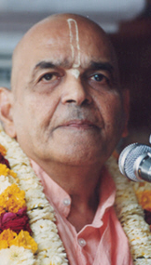
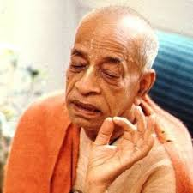
सहना Tolerate
Based on Bhagavat Saptah Lecture by HH Maha Vishnu Goswami Maharaj in Sydney

Slide 2
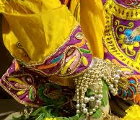
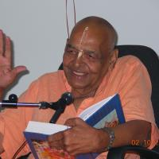
Recap
Duty in this age
Lead simple life
Don’t waste time in mental concoction
Utilize time in serious study of Bhagavatam
Medicine for this age
Hear, Study and Contemplate
Heart is meant for Krishna
Solution to our dissatisfaction
Spirit cannot be happy with matter.
Glorify Lord Sri Krishna
What is Real Wealth
Pleasing Krishna pleases everyone
Laxmi or Durga
Remembrance of Krishna

Slide 3
Recap
How to handle distress
Humbly Tolerance and have Patience
Improved karma leads to happiness
No one knows plan of the invisible actor
Art of Living
We have to go!
Blame yourself not others – See only Krishna
Eat sparingly and depend on Krishna
Dhruva Maharaj
Wish good to all and focus on Krishna!
God is great – worship Him
Take shelter of Krishna with determination
Bhisma Pitamah
Life of sacrifice
Doing duty in reverse circumstances
Seeing everything as Krishna’s favor

Slide 4
Recap
How to be fearless like Bhakta Prahlad
Chant Lord’s Names without delay
Fear personified fears Lord’s name
Worrying is business of Krishna

Slide 5
पुनरावृत्ति
इस युग में कर्तव्य
सादा जीवन जिए
मानसिक मनगढ़ंत में समय बर्बाद न करें
भागवतम् के गंभीर अध्ययन करें
इस युग के लिए दवा
तच्छृण्वन् सुपठन् विचारणपरो [SB 12.13.18]
हृदय कृष्ण के लिए है
हमारे असंतोष का समाधान
आत्मा पदार्थ से खुश नहीं हो सकती
भगवान कृष्ण की महिमा करें
वास्तविक धन क्या है
यास्मीन तुष्टे जगत् तुष्टे
लक्ष्मी या दुर्गा
कृष्ण का स्मरण

Slide 6
पुनरावृत्ति
संकट से कैसे निपटें ?
विनम्रता, धीरज, सभी का सम्मान
अच्छे कर्म से खुशी मिलती है
अदृश्य अभिनेता की योजना कोई नहीं जानता
जीने की कला
हमें जाना है
दूसरों को दोष न दें - केवल कृष्ण को देखें
संयमपूर्वक भोजन करें और कृष्ण पर निर्भर रहें
ध्रुव महाराज
सभी को शुभकामनाएं और कृष्ण पर ध्यान केंद्रित करें!
ईश्वर महान है - उसकी पूजा करो
निश्चय के साथ कृष्ण की शरण लें
भीष्म पितामह
बलिदान का जीवन
विपरीत परिस्थितियों कर्तव्य निभाना
सब कुछ में कृष्ण की कृपा देखना

Slide 7
पुनरावृत्ति
भक्त प्रह्लाद की तरह निडर कैसे बनें ?
बिना देर किए भगवान के नाम का जप करें
भय भी कृष्ण नाम से डरता है
चिंता करना कृष्ण का काम है

Slide 8
keshav keshav kükiye
keshav keshav kükiye na kükiye asär
rät divas ke kükte kabhi to sune pukär
räma näm ratate raho / kåñṇa näm ratate raho
jab lag ghat me prän (2)
kabahun to deena dayäl ke bhanak paregi kän
äj kahen mein käl bhajun käl kahen phir käl
äj käl ke karath hi jäsi avsar chäl
käl bhajantä äj bhaj äj bhajantä ab
do pal me parlay hoyegi phir bhajegä kab

Slide 9
केशव केशव कूकिये
केशव केशव कूकिये ना कूकिये आसार
रात दिवस के कूकते कभी तो सुने पुकार
राम नाम रटते रहो कृष्ण नाम रटते रहो
जब लग घट मे प्राण
कबाहू तो दीन दयाल के भनक पड़ेगी कान
आज कहे मैं काल भजुं काल कहे फिर काल
आज काल के करथ ही जासी अवसर चाल
काल भजंता आज भज आज भजंता अब
पल में परले होवेगी फिर भजेगा कब ?

Slide 10
आपन्न: संसृतिं घोरां यन्नाम विवशो गृणन् । तत: सद्यो विमुच्येत यद्ब‍िभेति स्वयं भयम् ॥
āpannaḥ saṁsṛtiṁ ghorāṁ yan-nāma vivaśo gṛṇan tataḥ sadyo vimucyeta yad bibheti svayaṁ bhayam
āpannaḥ — being entangled; saṁsṛtim — in the hurdle of birth and death; ghorām — too complicated; yat — what; nāma — the absolute name; vivaśaḥ — unconsciously; gṛṇan — chanting; tataḥ — from that; sadyaḥ — at once; vimucyeta — gets freedom; yat — that which; bibheti — fears; svayam — personally; bhayam — fear itself.
Living beings who are entangled in the complicated meshes of birth and death can be freed immediately by even unconsciously chanting the holy name of Kṛṣṇa, which is feared by fear personified. [SB 1.1.14]

Slide 11
Holy name of Krishna = Lord Sri Krishna
Vāsudeva, or Lord Kṛṣṇa, the Absolute Personality of Godhead, is the supreme controller of everything. There is no one in creation who is not afraid of the rage of the Almighty. Great asuras like Rāvaṇa, Hiraṇyakaśipu, Kaṁsa, and others who were very powerful living entities were all killed by the Personality of Godhead. And the almighty Vāsudeva has empowered His name with the powers of His personal Self. Everything is related to Him, and everything has its identity in Him. It is stated herein that the name of Kṛṣṇa is feared even by fear personified. This indicates that the name of Kṛṣṇa is nondifferent from Kṛṣṇa. Therefore, the name of Kṛṣṇa is as powerful as Lord Kṛṣṇa Himself. There is no difference at all. Anyone, therefore, can take advantage of the holy names of Lord Śrī Kṛṣṇa even in the midst of the greatest dangers. The transcendental name of Kṛṣṇa, even though uttered unconsciously or by force of circumstances, can help one obtain freedom from the hurdle of birth and death. [SB 1.1.14 purport]

Slide 12
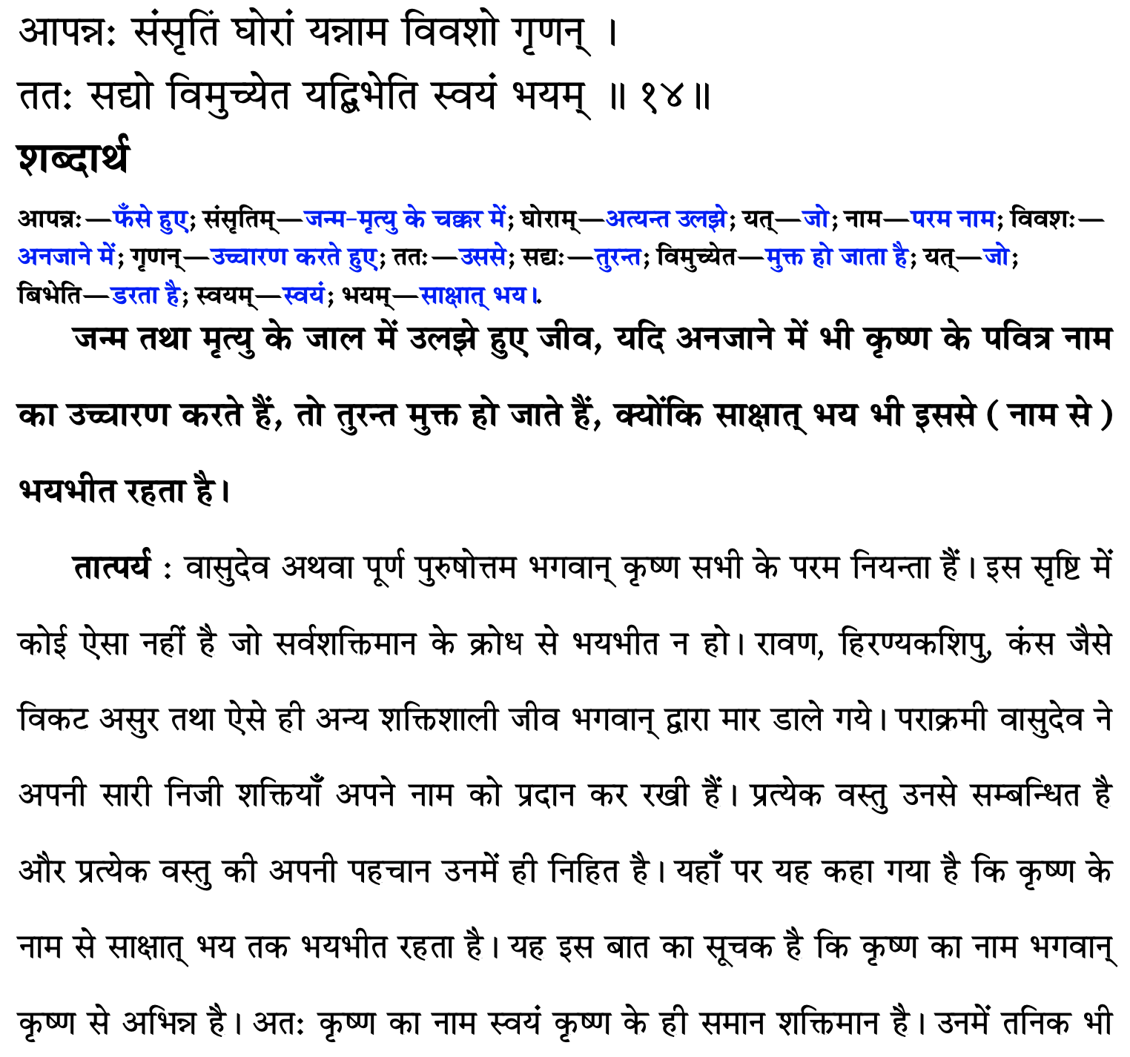

Slide 13
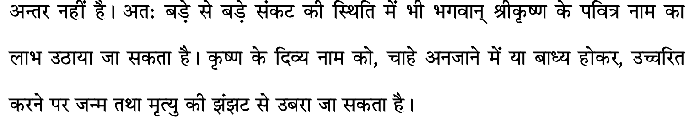

Slide 14
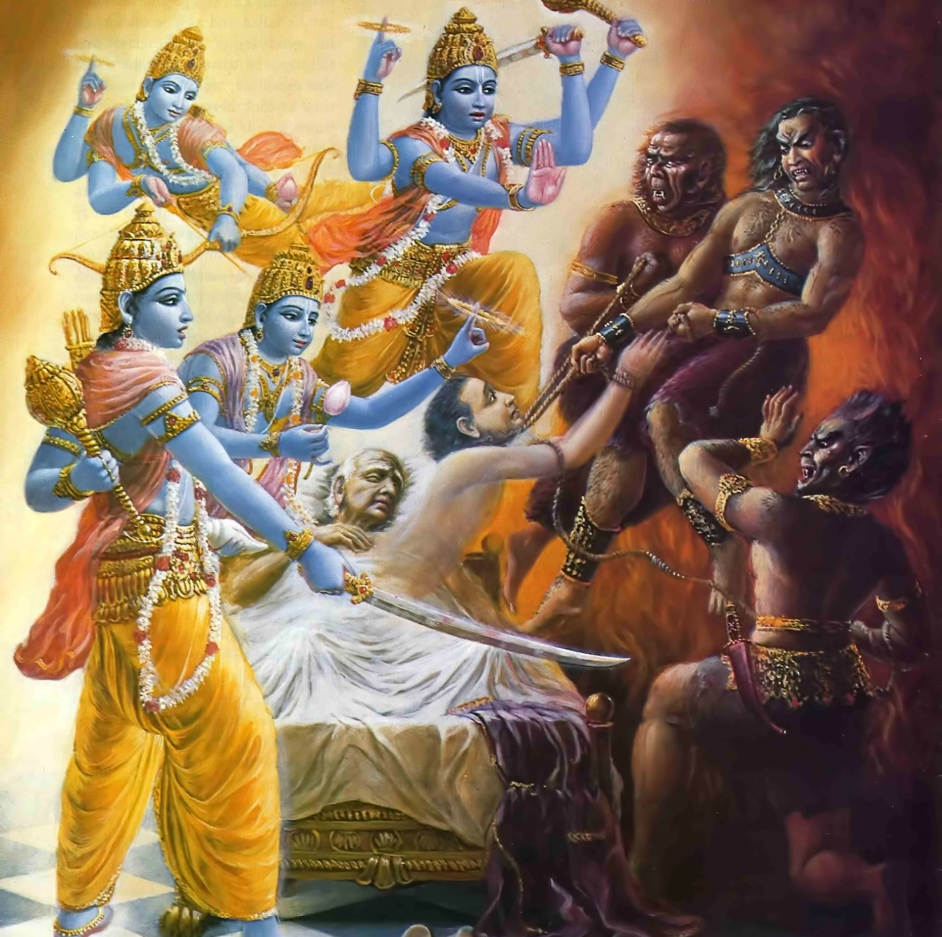
Ajamila
As soon as we helplessly and without offence chant His names, without any delay He comes to our rescue.
There is no difference between Lord and His name – being non-dual

Slide 15
Remedy of Fear : Chant His names
Will I get some disease?
Will I die?
Will my money go away?
Will my employer fire me?
Will America kick me out?
We are squeezed from all sides, Please don’t waste your time
There is only one solution: Chant His names – essence of all scriptures
Hare Krishna Hare Krishna Krishna Krishna Hare Hare
Hare Raam Hare Raam Raam Raam Hare Hare

Slide 16
Keshav Kirtana: Sum Total of all scriptures
älodyam sarva shästräni vichärya ca punah punah
idam ekam sunishpannam dhehyo näräyana sadä
alodyam=scrutinizingly read; vichärya= thought over; punah punah=again and again; dhehyo=meditate
I have scrutinizing read all the scriptures. And not only read, but again and again I have thought over it. Only one thought comes out. Always the names of Narayana (Kåñëa) should be meditated on, nothing else. [Skanda purana, Linga Purana and Padma purana]

Slide 17
Faith in scriptures is needed
We need guidance from someone
Wrong guidance will lead to wrong destination
Instead of North we will go South
There is lot of cheating in the spiritual path
Wherever there is some motivation for money there is definitely cheating
Who has written these scriptures?
Inference – these are not written by humans
Building exists – builder, carpenter, mason, workers, etc. must be there
adau shradha – first we must have faith

Slide 18
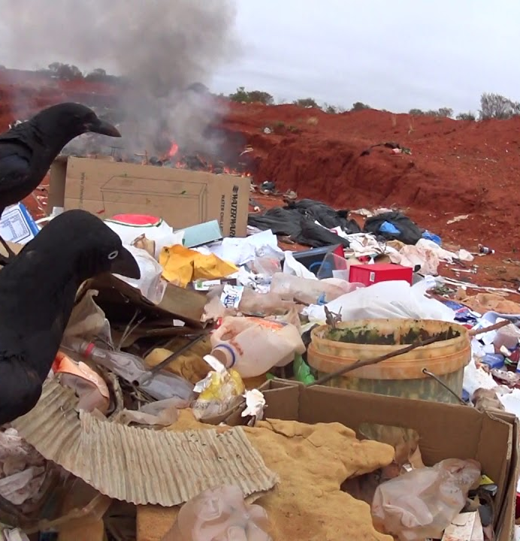
Pilgrim center for crows
na yad vacaś citra-padaà harer yaśo
jagat-pavitraà pragåṇīta karhicit
tad väyasaà tīrtham uśanti mänasä
na yatra haàsä niramanty uśik-kñayäḥ
Those words, which do not describe the glories of the Lord, who alone can sanctify the atmosphere of the whole universe, are considered by saintly persons to be like unto a place of pilgrimage for crows. Since the all-perfect persons are inhabitants of the transcendental abode, they do not derive any pleasure there. [SB 1.5.10]

Slide 19
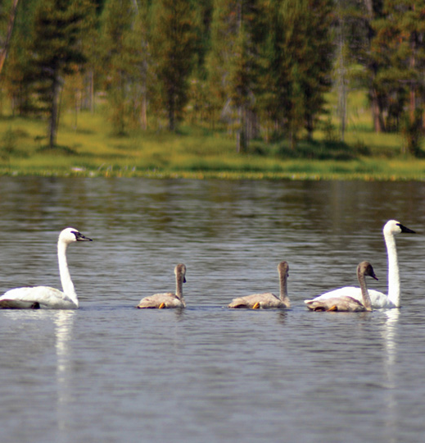
What can bring revolution?
tad-väg-visargo janatägha-viplavo
yasmin prati-ślokam abaddhavaty api
nämäny anantasya yaśo ’ṅkitäni yat
śṛṇvanti gäyanti gṛṇanti sädhavaḥ
On the other hand, that literature which is full of descriptions of the transcendental glories of the name, fame, forms, pastimes, etc., of the unlimited Supreme Lord is a different creation, full of transcendental words directed toward bringing about a revolution in the impious lives of this world's misdirected civilization. Such transcendental literatures, even though imperfectly composed, are heard, sung and accepted by purified men who are thoroughly honest. [SB 1.5.11]

Slide 20
Worry is business of Krishna
We are not busy – we are lazy
Wake up early and chant
Sleep early
Have faith and chant His names
Our business is to chant His names and catch His lotus feet firmly
Don’t worry – chinta vs chita
Worry about not being able to read pious literatures

Slide 21
अर्जुन उवाच कृष्ण कृष्ण महाबाहो भक्तानामभयङ्कर । त्वमेको दह्यमानानामपवर्गोऽसि संसृते: ॥ २२ ॥ arjuna uvāca kṛṣṇa kṛṣṇa mahā-bāho bhaktānām abhayaṅkara tvam eko dahyamānānām apavargo ’si saṁsṛteḥ
arjunaḥ uvāca — Arjuna said; kṛṣṇa — O Lord Kṛṣṇa; kṛṣṇa — O Lord Kṛṣṇa; mahā-bāho — He who is the Almighty; bhaktānām — of the devotees; abhayaṅkara — eradicating the fears of; tvam — You; ekaḥ — alone; dahyamānānām — those who are suffering from; apavargaḥ — the path of liberation; asi — are; saṁsṛteḥ — in the midst of material miseries.
Arjuna said: O my Lord Śrī Kṛṣṇa, You are the almighty Personality of Godhead. There is no limit to Your different energies. Therefore only You are competent to instill fearlessness in the hearts of Your devotees. Everyone in the flames of material miseries can find the path of liberation in You only.[SB 1.7.22]

Slide 22
Reviving our original quality
Kṛṣṇa is the original source of all living entities. This is confirmed in Bhagavad-gītā (15.7), wherein Kṛṣṇa says:
mamaivāṁśo jīva-loke jīva-bhūtaḥ sanātanaḥ manaḥ ṣaṣṭhānīndriyāṇi prakṛti-sthāni karṣati
“The living entities in this conditioned world are My eternal, fragmental parts. Due to conditioned life, they are struggling very hard with the six senses, which include the mind.” All living entities are part and parcel of Kṛṣṇa, and therefore when they revive their original Kṛṣṇa consciousness, they possess all the good qualities of Kṛṣṇa in a small quantity. When one engages himself in the nine processes of devotional service (śravaṇaṁ kīrtanaṁ viṣṇoḥ smaraṇaṁ pāda-sevanam/ arcanaṁ vandanaṁ dāsyaṁ sakhyam ātma-nivedanam), one’s heart becomes purified, and he immediately understands his relationship with Kṛṣṇa. He then revives his original quality of Kṛṣṇa consciousness.

Slide 23
Samsara Davanala Lidha Loka
saḿsāra-dāvānala-līḍha-loka-trāṇāya kāruṇya-ghanāghanatvam prāptasya kalyāṇa-guṇārṇavasya vande guroḥ śrī-caraṇāravindam
The spiritual master is receiving benediction from the ocean of mercy. Just as a cloud pours water on a forest fire to extinguish it, so the spiritual master delivers the materially afflicted world by extinguishing the blazing fire of material existence. I offer my respectful obeisance unto the lotus feet of such a spiritual master, who is an ocean of auspicious qualities.

Slide 24
Connecting Verses
BG 15.7: mamaivāṁśo jīva-loke jīva-bhūtaḥ sanātanaḥ manaḥ-ṣaṣṭhānīndriyāṇi prakṛti-sthāni karṣati
karṣati — is struggling hard.
Troubles come even unwanted
BG 13.9: janma-mṛtyu-jarā-vyādhi-duḥkha-doṣānudarśanam
Root cause of miseries – desires to enjoy senses -
BG 5.22: ye hi saṁsparśa-jā bhogā duḥkha-yonaya eva te
Material senses are sources of misery -
BG 7.14 daivī hy eṣā guṇa-mayī mama māyā duratyayā mām eva ye prapadyante māyām etāṁ taranti te
To cross easily - Surrender to Him
BG 2.7: kārpaṇya-doṣopahata-svabhāvaḥ pṛcchāmi tvāṁ dharma-sammūḍha-cetāḥ yac chreyaḥ syān niścitaṁ brūhi tan me śiṣyas te ’haṁ śādhi māṁ tvāṁ prapannam
BG 18.66: sarva-dharmān parityajya mām ekaṁ śaraṇaṁ vraja ahaṁ tvāṁ sarva-pāpebhyo mokṣayiṣyāmi mā śucaḥ

Slide 25
Connecting Verses
SB 1.7.6: anarthopaśamaṁ sākṣād bhakti-yogam adhokṣaje lokasyājānato vidvāṁś cakre sātvata-saṁhitām
The material miseries of the living entity, which are superfluous to him, can be directly mitigated by the linking process of devotional service. But the mass of people do not know this, and therefore the learned Vyāsadeva compiled this Vedic literature, which is in relation to the Supreme Truth.
SB 1.7.7: yasyāṁ vai śrūyamāṇāyāṁ kṛṣṇe parama-pūruṣe bhaktir utpadyate puṁsaḥ śoka-moha-bhayāpahā
Simply by giving aural reception to this Vedic literature, the feeling for loving devotional service to Lord Kṛṣṇa, the Supreme Personality of Godhead, sprouts up at once to extinguish the fire of lamentation, illusion and fearfulness.

Slide 26
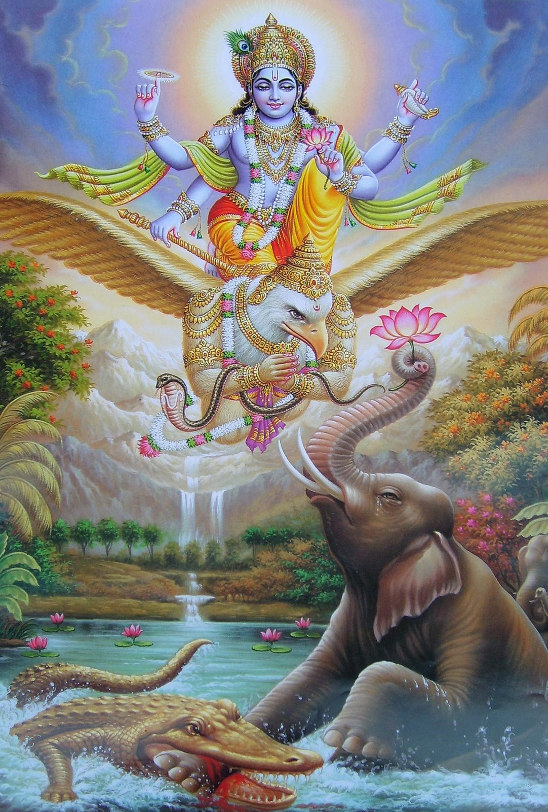
Intelligence – seek refuge
yaḥ kaścaneśo balino ’ntakoragāt pracaṇḍa-vegād abhidhāvato bhṛśam bhītaṁ prapannaṁ paripāti yad-bhayān mṛtyuḥ pradhāvaty araṇaṁ tam īmahi
yaḥ — He who (the Supreme Personality of Godhead); kaścana — someone; īśaḥ — the supreme controller; balinaḥ — very powerful; antaka-uragāt — from the great serpent of time, which brings death; pracaṇḍa-vegāt — whose force is fearful; abhidhāvataḥ — who is chasing; bhṛśam — endlessly (every hour and every minute); bhītam — one who is afraid of death; prapannam — who is surrendered (to the Supreme Personality of Godhead); paripāti — He protects; yat-bhayāt — from fear of the Lord; mṛtyuḥ — death itself; pradhāvati — runs away; araṇam — the actual shelter of everyone; tam — unto Him; īmahi — I surrender or take shelter.
The Supreme Personality of Godhead is certainly not known to everyone, but He is very powerful and influential. Therefore, although the serpent of eternal time, which is fearful in force, endlessly chases everyone, ready to swallow him, if one who fears this serpent seeks shelter of the Lord, the Lord gives him protection, for even death runs away in fear of the Lord. I therefore surrender unto Him, the great and powerful supreme authority who is the actual shelter of everyone. [SB 8.2.33]

Slide 27
13.9: Staircase to Lord Krishna (SPG)
Humility: one should not be anxious to have the satisfaction of being honored by others
pridelessness;
Nonviolence: not to put others into distress
Tolerance: practiced to bear insult and dishonor from others. Ex. Prahlad Maharaj
simplicity; without diplomacy one should be so straightforward that he can disclose the real truth even to an enemy
approaching a bona fide spiritual master: with all humility and offer him all services so that he will be pleased
Cleanliness: External cleanliness like taking a bath;internal cleanliness like always think of Kṛṣṇa and chant
Steadiness: very determined to make progress in spiritual life
self-control: not accept anything which is detrimental to the path of spiritual progress
renunciation of the objects of sense gratification;
absence of false ego;
the perception of the evil of birth, death, old age and disease;
detachment;
freedom from entanglement with children, wife, home and the rest;
even-mindedness amid pleasant and unpleasant events;
constant and unalloyed devotion to Me;
aspiring to live in a solitary place;
detachment from the general mass of people;
accepting the importance of self-realization;
philosophical search for the Absolute Truth

Slide 28
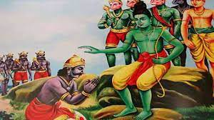
sakṛd eva prapanno yas tavāsmīti ca yācate abhayaṁ sarvadā tasmai dadāmy etad vrataṁ mama (Rāmāyaṇa, Yuddha-kāṇḍa 18.33)
I give them fearlessness. “That is my vrata. That is my vow” He says, and He never deters from His vows.

Slide 29
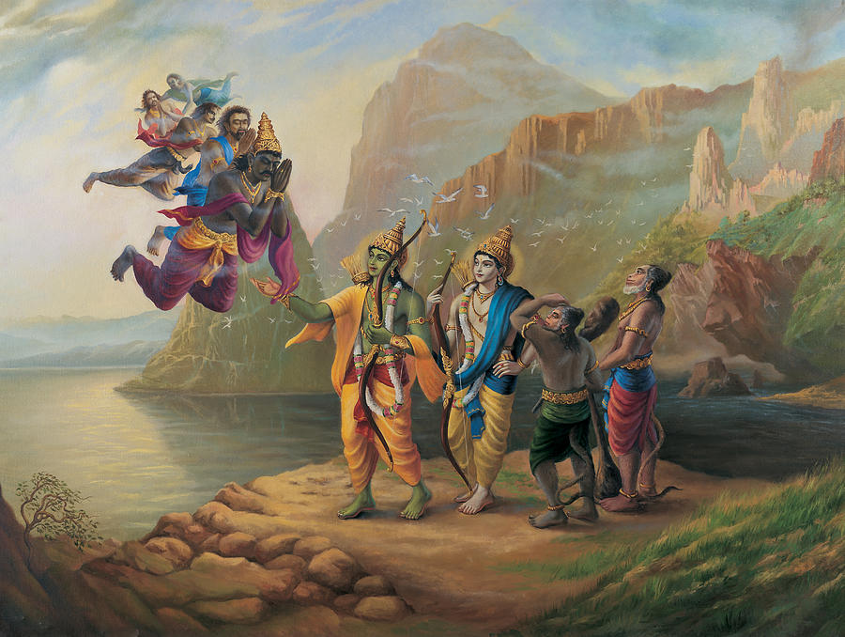

Slide 30
Straight forward gives fearlessness
Our life is very straight forward. There are no corners in it. And because it is without the corners, so the dirt cannot accumulate. The dirt can only accumulate, in the corners. If the room is straight forward, the dirt cannot accumulate. Our mind, because of constant remembrance of Krishna, is completely clarified of these dirt. And because there is no dirt, there is no anxiety, there is no misery at all. The miseries only when your mind has the corners and the corners are full of dirt. Please remove the corners from your mind and you will be fearless by His mercy.
Maha Vishnu Goswami

Slide 31
Chitā vs Chintā – be fiery with Krishna names
Chitā burns the dead body and Chintā burns the live body
So, please somehow or the other get rid of this anxiety. And there is no other way, You have to be very feelingly chanting about Krishna’s names. And you please call Him.
He is known as avyaya, He is completely fixed in His promises. We may deter, because we are limited in capacity. He is unlimited, you know and because of the unlimited Ananta, because of His Ananta nature, He can vanquish our anxieties and miseries within a second. And that is the purifying agent. The more you hear about Him;
Anxieties will pounce on you as soon as Krishna is absent, kaliyuga anxieties are on our shoulder. tad dinaat, kali aayaatah. kshmaam tyaktva, He left the planet, and sva padam gatah, and He went to His own abode, and tad dinaat, and from that day, Kaliyuga has come.
Material existence can only be mitigated by un-deviated devotional service unto the lotus feet of Krishna. Otherwise it can never be mitigated.

Slide 32
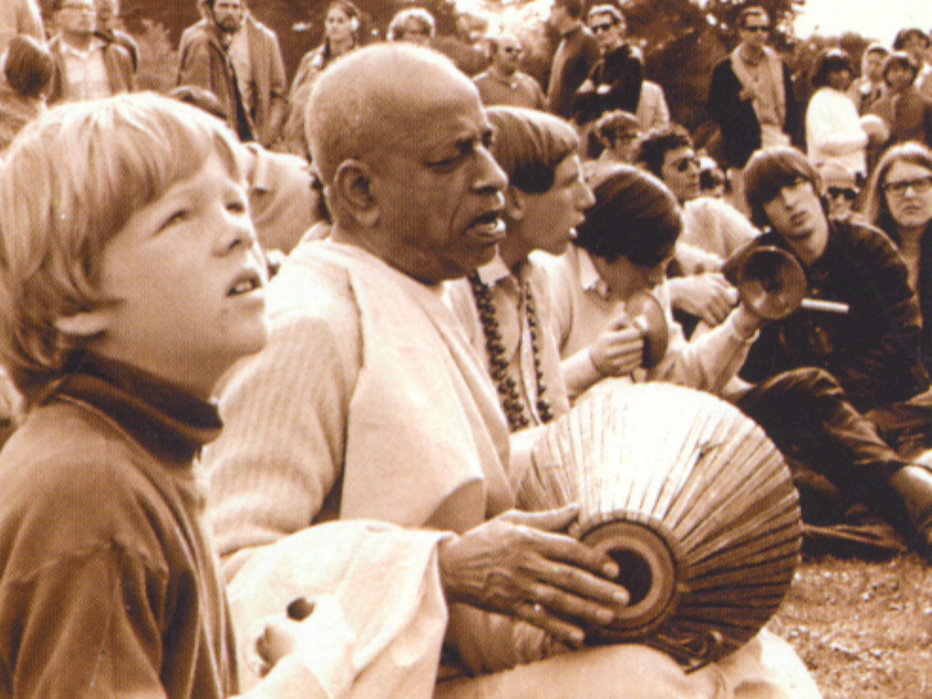
Srila Prabhupada depends only on Harinaam
Ignored material standards
Wear dhoti
nāmāny anantasya hata-trapaḥ paṭhan guhyāni bhadrāṇi kṛtāni ca smaran gāṁ paryaṭaṁs tuṣṭa-manā gata-spṛhaḥ kālaṁ pratīkṣan vimado vimatsaraḥ
Thus I began chanting the holy name and fame of the Lord by repeated recitation, ignoring all the formalities of the material world. Such chanting and remembering of the transcendental pastimes of the Lord are benedictory. So doing, I traveled all over the earth, fully satisfied, humble and unenvious. [SB 1.6.26]

Slide 33
Propagate - Don’t care for material standards
Prabhupada has given that first, with dhotis they go out for Harinama, they don’t care for the material standards.
In London or in European countries or in America or in Australia also, we go for Harinaam and we ignore all the standards because we are completely engrossed in the chanting the names of Krishna. This is the way, we should pass time. guhyāni bhadrāṇi kṛtāni ca smaran“I was always remembering His inconceivable activities.”

Slide 34
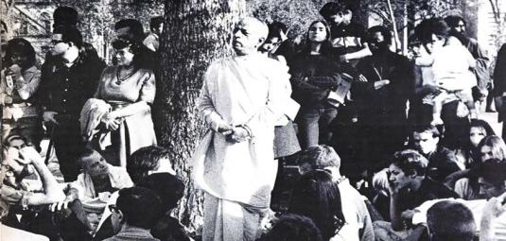

Slide 35
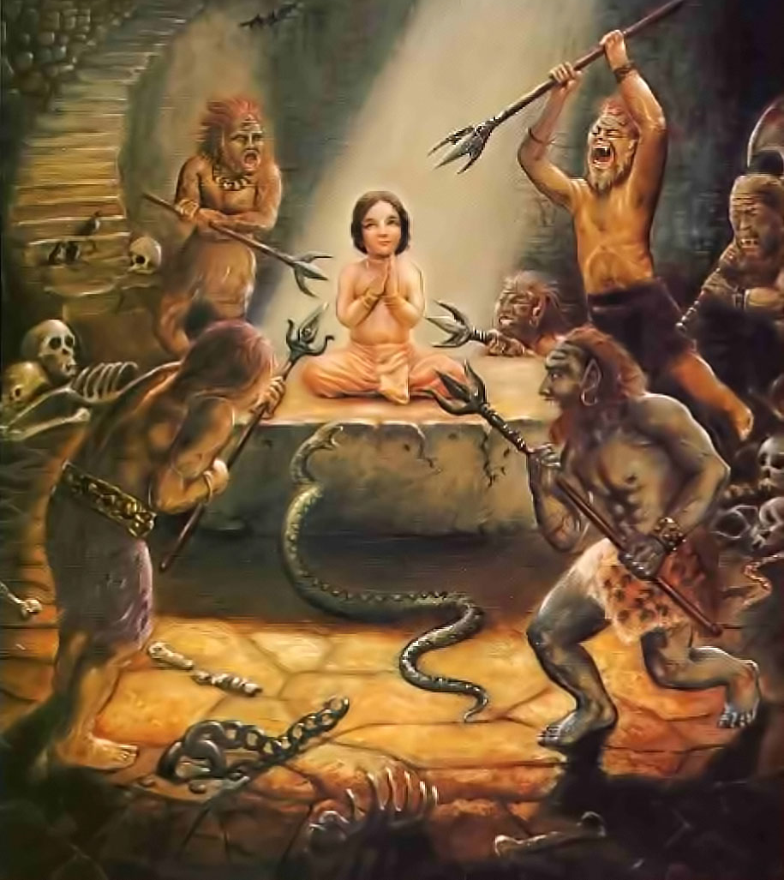
Fearless Bhakta Prahlad

Slide 36
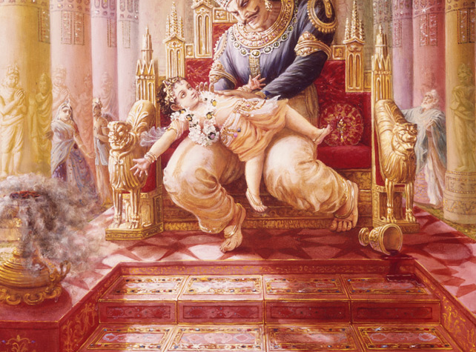

Slide 37
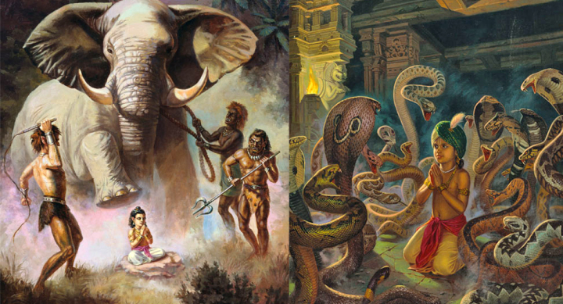

Slide 38
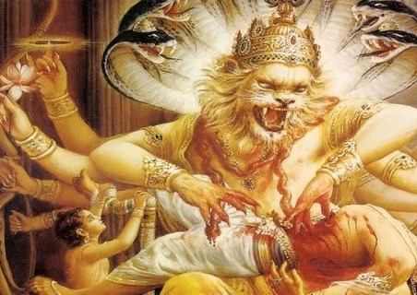
त्रैपिष्टपोरुभयहा स नृसिंहरूपं कृत्वा भ्रमद्भ्रुकुटिदंष्ट्रकरालवक्त्रम् । दैत्येन्द्रमाशु गदयाभिपतन्तमारा- दूरौ निपात्य विददार नखै: स्फुरन्तम् ॥ १४ ॥
trai-piṣṭaporu-bhaya-hā sa nṛsiṁha-rūpaṁ kṛtvā bhramad-bhrukuṭi-daṁṣṭra-karāla-vaktram daityendram āśu gadayābhipatantam ārād ūrau nipātya vidadāra nakhaiḥ sphurantam
The Personality of Godhead assumed the incarnation of Nṛsiṁhadeva in order to vanquish the great fears of the demigods. He killed the king of the demons [Hiraṇyakaśipu], who challenged the Lord with a club in his hand, by placing the demon on His thighs and piercing him with His nails, rolling His eyebrows in anger and showing His fearful teeth and mouth.

Slide 39
Powerful Hiranyakashipu vanquished
Hiranyakashipu was so very tall that he was touching the clouds
He was the owner of all the heavenly planets.
The demigods were shivering before him and even then he was defeated by Krishna.
Such a powerful Lord is in our hands
So please, such a powerful Lord is in our hands, just is the matter of devoting some time.

Slide 40
Bhaja hu re mana
bhajahū re mana śrī-nanda-nandana abhaya-caraṇāravinda re durlabha mānava-janama sat-sańge taroho e bhava-sindhu re
O mind just worship the lotus feet of the son of Nanda, which make one fearless. Having obtained this rare human birth, cross over this ocean of worldly existence through the association of saintly persons.
śīta ātapa bāta bariṣaṇa e dina jāminī jāgi re biphale sevinu kṛpaṇa durajana capala sukha-laba lāgi' re
Both in the day and at night I remain sleepless, suffering the pains of the heat and cold, the wind and the rain. For a fraction of flickering happiness I have uselessly served wicked and miserly men.
e dhana, yaubana, putra, parijana ithe ki āche paratīti re kamala-dala-jala, jīvana ṭalamala bhajahū hari-pada nīti re
What assurance of real happiness is there in all of one's wealth, youthfulness, sons, and family members? This life is tottering like a drop of water on a lotus petal; therefore you should always serve and worship the divine feet of Lord Hari.
śravaṇa, kīrtana, smaraṇa, vandana, pāda-sevana, dāsya re pūjana, sakhī-jana, ātma-nivedana govinda-dāsa-abhilāṣa re
It is the desire and great longing of Govinda Dasa to engage himself in the nine processes of bhakti, namely hearing the glories of Lord Hari and chanting those glories, constantly remembering Him and offering prayers to Him, serving the Lord's lotus feet, serving the Supreme Lord as a servant, worshiping Him with flowers and incense and so forth, serving Him as a friend, and completely offering the Lord one's very self.

Slide 41
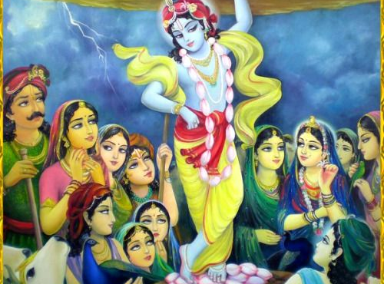

Slide 42
Prayer unto lotus feet of Gurudeva that I may please learn how to …
Wake up early giving up laziness and wasting time
Have firm faith in holy names and sastras
Chant the holy names of the Lord without any offence
Read, study and introspect literatures that glorify Lord Sri Krishna
Perform my duties with good behavior while remembering Lord.
Eagerly seek guidance and lovingly serve Gurudeva

Slide 44
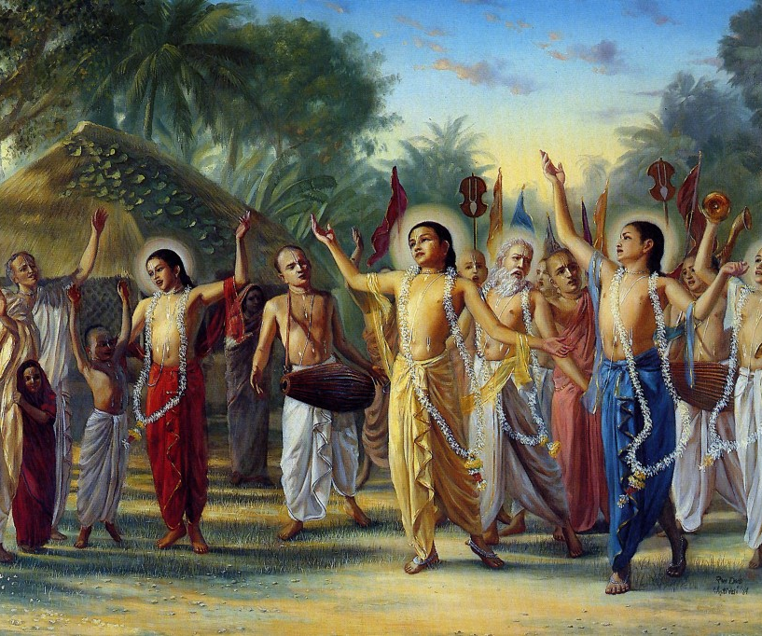
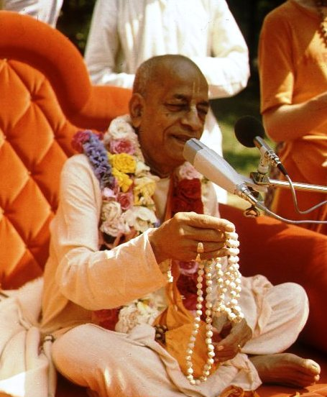
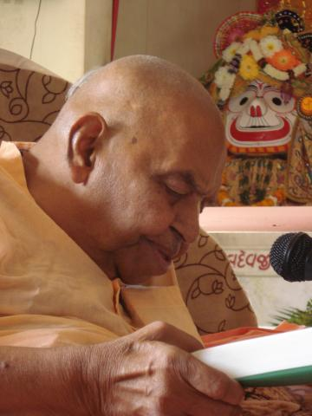
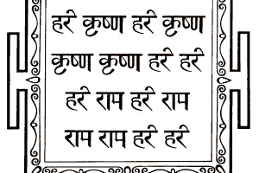
हरे कृष्णा
श्रील प्रभुपाद की जय
गुरुदेव की जय

